Slide 1

A Comprehensive Assessment of Current Sustainability Efforts at UTHealth
William Hebel, MB(ASCP)^{CM}
^{August 2021}

Slide 2

Sustainability (Sustainable Development)
(noun) - səˌstānəˈbilədē
    “Sustainable development seeks to meet the needs and aspirations of the present without compromising the ability to meet those of the future.”
    – The 1987 United Nations Brundtland Commission Report ¹
    ‌

Slide 3
Project origin and purpose:
There are many ongoing sustainability efforts at UTHealth, but no central catalog currently exists to communicate these
UT System policy – UTS 169 Sustainability Practices requires institutions to consider sustainability on campus https://www.utsystem.edu/sites/policy-library/policies/uts-169-sustainability-practices
At the request of the UTHealth Safety Council, SHERM was tasked to assemble information on sustainability
    ‌

Slide 4
Project goals:
Identify key stakeholders at UTHealth currently engaged in sustainability efforts
Catalogue and showcase current sustainability efforts at UTHealth, some of which are student led and not administrative, and communicate them via a newly developed webpage (https://www.uth.edu/safety/sherm/sustainability)
Present findings to the UTHealth Safety Council membership, student groups, and other interested individuals or groups
    ‌

Slide 5
Stakeholders at UTHealth included in evaluation:
Facilities, Planning, and Engineering (FPE)
Auxiliary Enterprises (AE)
Safety, Health, Environment & Risk Management (SHERM)
Procurement and Finance
Capital Assets Management
Information Technology (IT)
Note: other sustainability efforts exist on campus, but the above list represents major administrative departments/units involved in the implementation / management of sustainability
    ‌

Slide 6

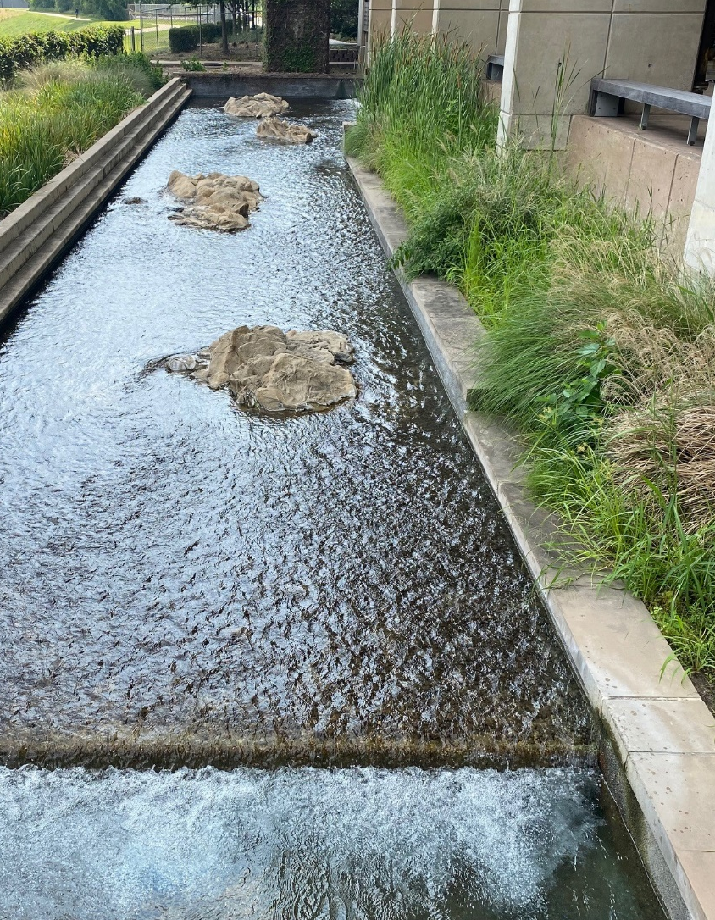
Facilities, Planning, and Engineering
Energy Conservation Opportunities (ECO)
  Temperature/Humidity policy
    Settings at 73.5°F and <60% humidity
    Exceptions for animal housing
    10% total energy cost reduction in FY20
  Chiller condensate recovery program
    HVAC condensate is collected and repurposed
    Resulted in 20% water use savings for IMM/SRB landscape irrigation
  Plans are in place to direct the recovered condensate at MSB into the DI water system for the laboratories

Slide 7
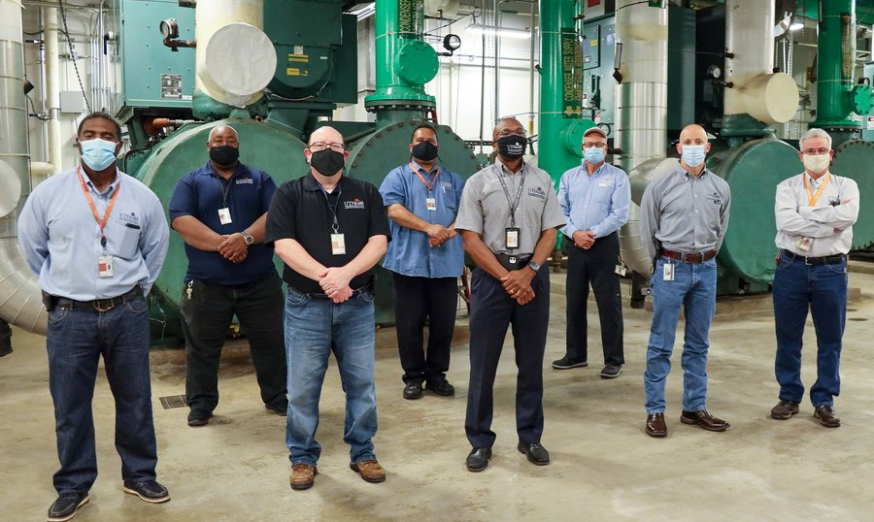
Facilities, Planning, and Engineering
Energy Conservation Opportunities (ECO)
  Fluorescent bulb LED replacement program
    1,100 bulbs and 5,400 fixtures replaced campus wide
    Projected 79% reduction in lighting costs
  Program Resets and Economizers
    Automatic HVAC adjustments based on weather
    FY20 resulted in a reduction of 247,780 ton hours of operation at a savings of $493,134

Slide 8
Facilities, Planning, and Engineering
Occupancy sensors
  Area lighting is controlled by occupancy
  Sensors in front of chemical fume hoods reduce exhaust fan use
  Variable ACR units allow for the reduction in HVAC operation in vacant areas
    Minimum ventilation rates are all ASHRAE standard compliant
Electrical demand reductions from ECO’s all contribute to a carbon emissions reduction across the UTHealth campus
Resulting ECO reductions
  7,098,831 kilowatt-hours of electricity usage
  Cost savings of $404,598 for UTHealth in FY20
  This represents an emissions reduction from electricity generation of 3,517 tons of carbon dioxide in FY20. ⁴

Slide 9
Facilities, Planning, and Engineering
Recycling Activities
  Corrugated cardboard recycling
    35.49 tons in FY20
    UTHealth receives monetary compensation based on current market value
  Co-mingled recyclables (plastic, paper, glass…)
    89.18 tons in FY20
Sustainable Drinking Water
  Bottle Filler Stations
    approx. 50k bottle equivalents filled since program start resulting in significant plastic bottle waste

Slide 10

Facilities, Planning, and Engineering
The UTHealth Facilities, Planning, and Engineering (FPE) department was featured in the July/August 2021 online publication of the APPA Facilities Manager journal.
https://www.appa.org/facilities-manager/uthealth-facilities-energy-conservation-plan-saves-millions/

Slide 11

Auxiliary Enterprises
Student and staff transportation services
  Shuttle services
  UTHealth Mobility Program
    UTHealth was awarded the 2021 METRO STAR Vanpool Earth Month Environmental Impact Award by METRO Star Vanpool and the Houston-Galveston Area Council
Water use minimizations
  Student Housing
    1,064 showerheads installed meeting EPA’s WaterSense criteria
    Approx. $25,000 in water use savings
  Recreation Center
    Bottle filler, stations, automatic flush toilets, waterless urinals, and an irrigation rain sensor installed

Slide 12
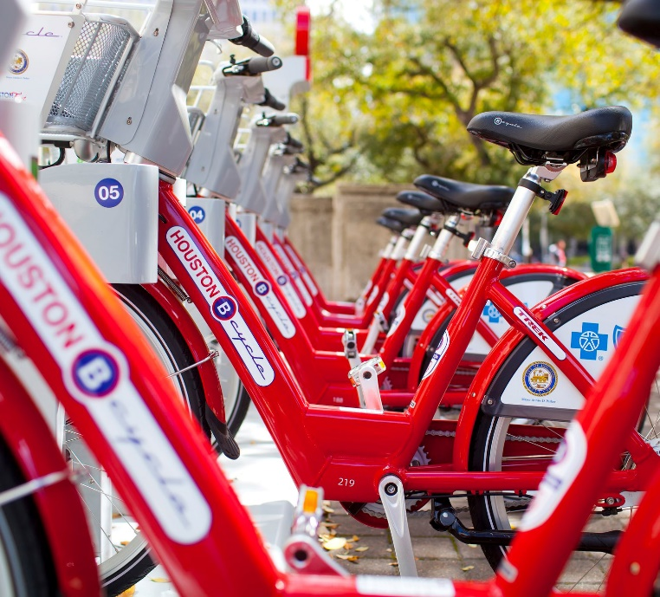
Auxiliary Enterprises
Energy use efficiencies
  LED lighting, occupancy sensors, and exterior lighting timers have been installed at the UTHealth Rec. Center
  The HVAC system in the Rec. Center had been updated and is controlled through the MetaSys system
  Partnered with the “Houston B-cycle” program with 12 bike rental stations in the Texas Medical Center area

Slide 13
Safety, Health, Environment & Risk Management (SHERM)
Hazardous waste minimization reduction efforts
  Research protocol reviews and “Green Chemistry” recommendations
  Pollution prevention planning
  Optimized waste processing to minimize quantity prior to disposal
  Annual sampling of laboratory waste water
  Recycling of waste materials (lamps, ballasts, paints, used oil, spent batteries, silver, mercury, etc.)
  FY20 hazardous waste minimization efforts by SHERM staff resulted in a disposal cost avoidance of $142,484

Slide 14
Safety, Health, Environment & Risk Management (SHERM)
  Green Chemistry options for safer, less hazardous chemicals in our research
  Comprehensive Asset Tracking and Environmental Release (CATER) Program
    Surplus equipment is inspected for hazardous materials prior to release to the warehouse in order to protect employees, the environment, and public buyers of UTHealth surplus equipment.
    Refrigerants captured from devices prior to disposal
  Fleet Vehicle maintenance to minimize hazardous emissions
Notes:
1\

Slide 15
Procurement and Finance
Currently, Procurement does not have sustainability programs in place but is working to develop sustainable purchasing relationships with vendors
Promote “circular purchasing” vendor relationships that will move purchasing away from the "Take, Make, Waste" model

Slide 16
Capital Assets Management
Equipment reuse
  Repurposing used equipment for redeployment within UTHealth to reduce the costs associated with purchasing new devices.
Computer equipment donation
  Devices that have reached their end-of-service life at UTHealth are donated to charitable entities for re-use.
Auctioning used equipment and materials for reuse, recycling, or recovery

Slide 17
Information Technology (IT)
Hot Aisle Containment Data Center
  The UTHealth server room is designed to capture the hot air from servers and direct it to a/c units rather than recycling and air conditioning all of the air in the room.
Computer Monitor/Hard Disk Drive sleep mode
  During periods of inactivity, monitors and disk drives go into “sleep mode”, reducing energy consumption. This effort is magnified by the thousands of computers across campus.
“Right sizing” things to the Cloud
  Reduces the equipment overhead cost by taking advantage of cloud server storage

Slide 18
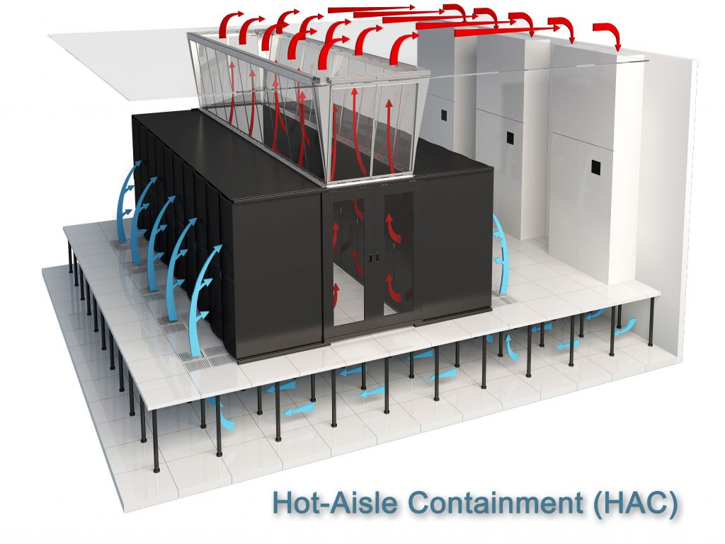
Information Technology (IT)
Illustration of the layout of the Hot Aisle Containment Data Center airflow

Slide 19
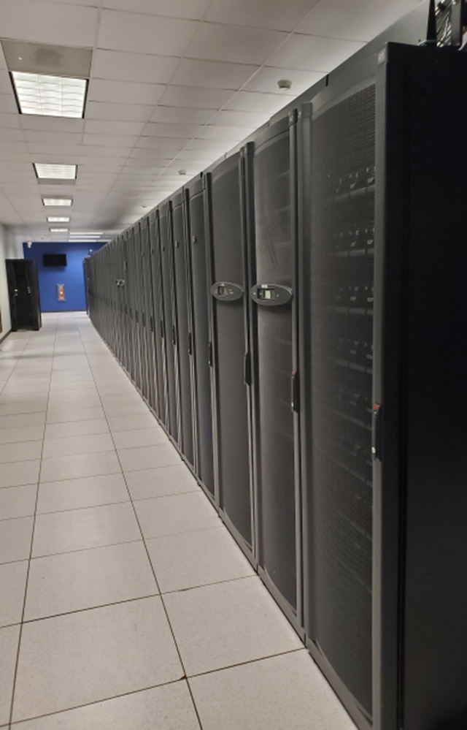
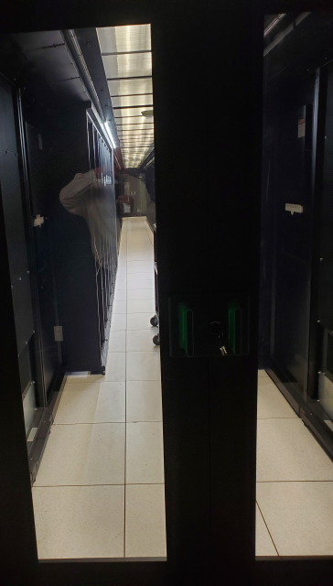
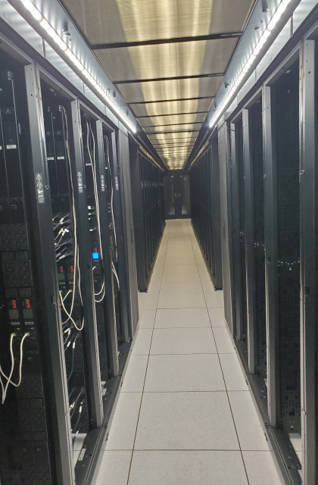

UTHealth Hot Aisle Containment Data Center
Hot Aisle
Hot Aisle

Slide 20
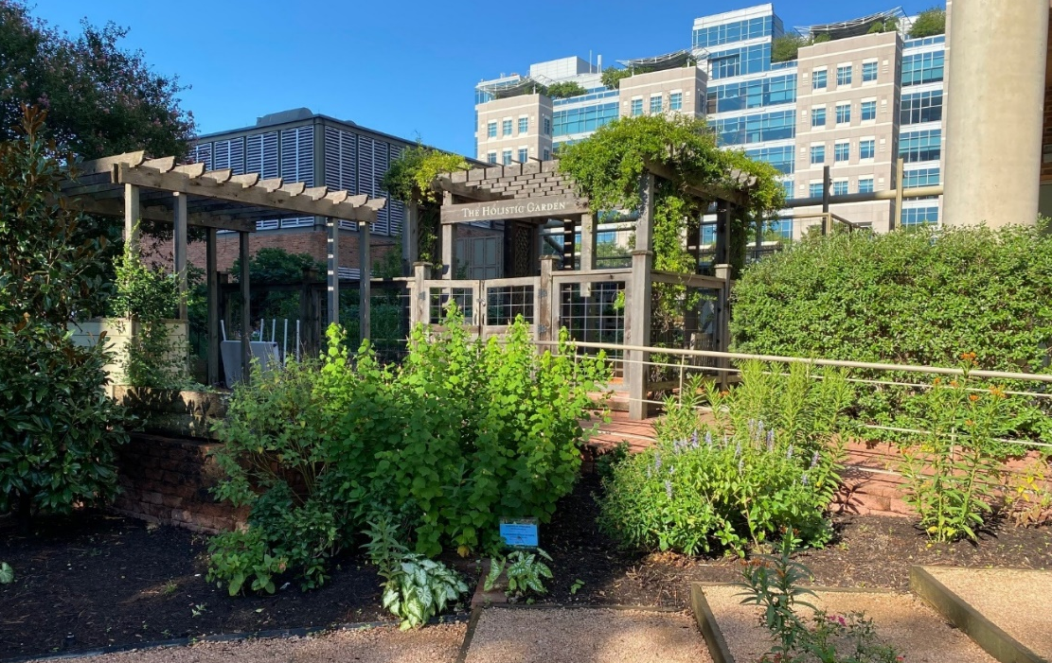
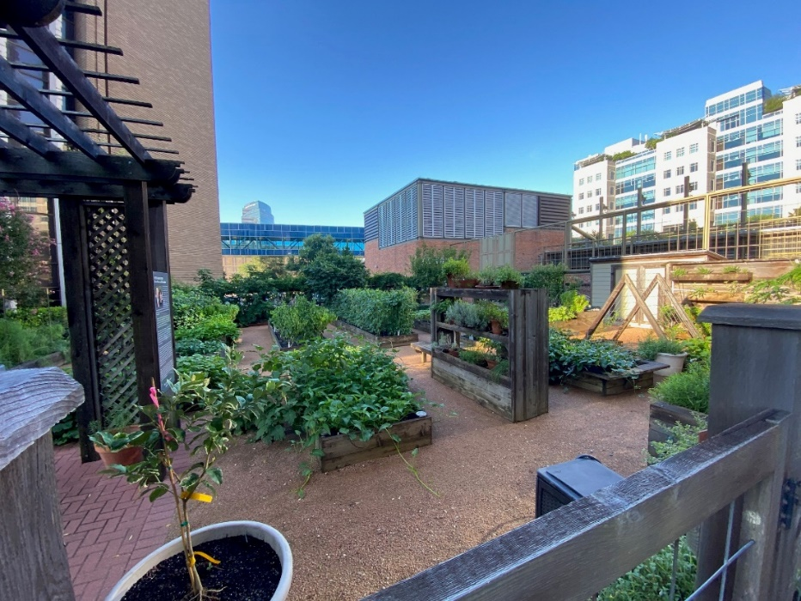
Other Sustainability Efforts on Campus
The UTHealth School of Public Health’s Holistic Garden
Part of the UTHealth School of Public Health's Nourish Program
Provides a sustainable source of produce for nutrition education (teaching kitchen) and other public health curricula

Slide 21
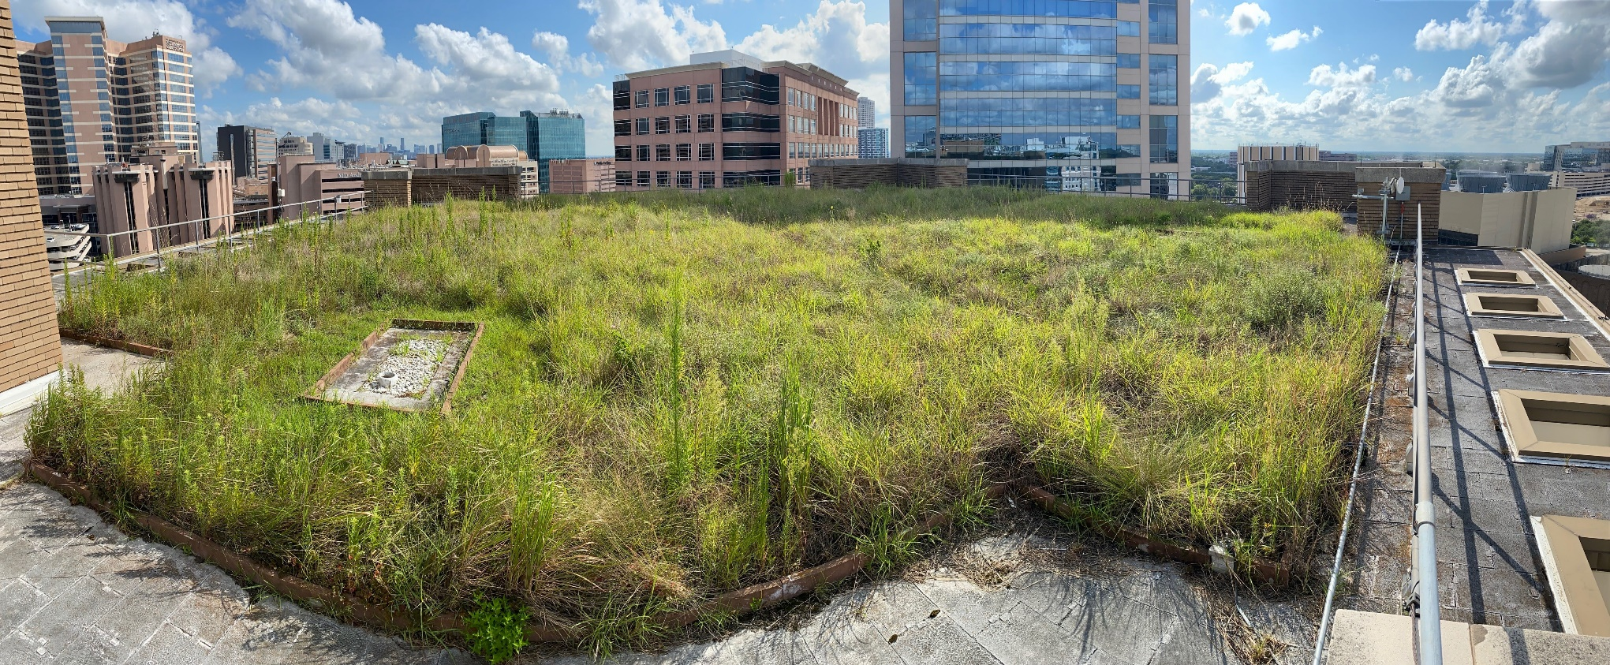
The School of Public Health Green Roof
Reduces the air temperature in the building by lowering the flow of heat into the building and lowers cooling costs
Only on the East Tower at SPH, allowing for comparisons to the traditional roof design of the West Tower

Slide 22
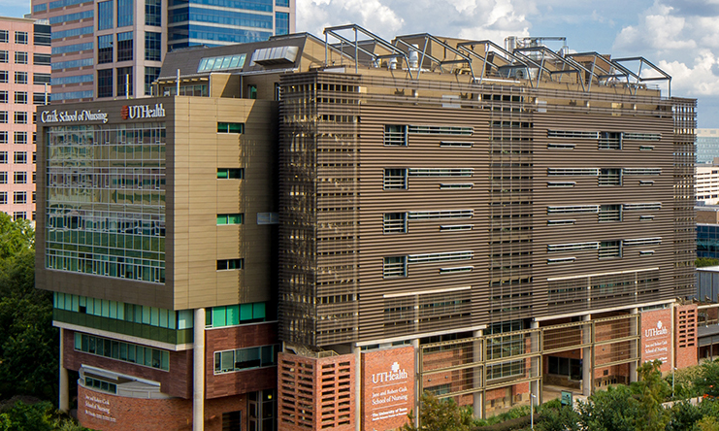
The Cizik School of Nursing
LEED (Leadership in Energy and Environmental Design) Gold certification awarded by the U.S. Green Building Council on 2/5/2009
The first LEED Gold building in The University of Texas System
Recognized as one of the top green academic buildings in the U.S.

Slide 23
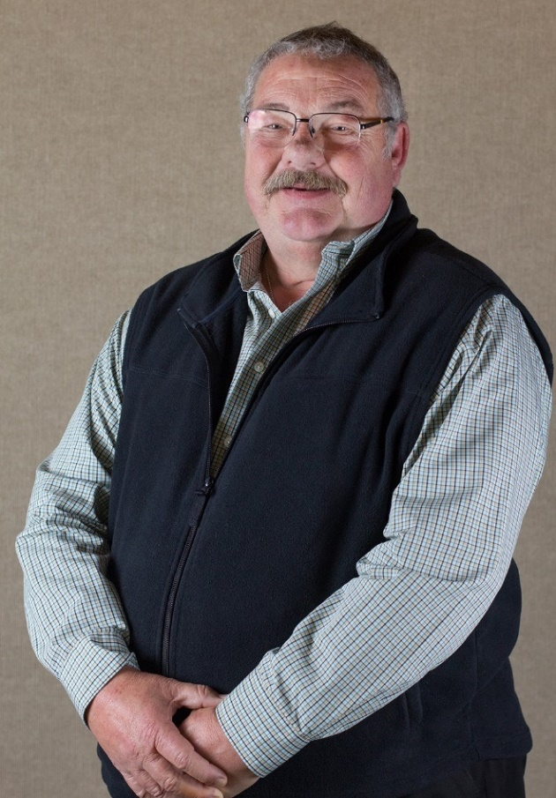
Brian Yeoman
Former UTHealth Assoc. Vice Pres. of Facilities
in memoriam (1950-2021)
UTHealth pioneer in sustainable building and procurement
  Cizik School of Nursing LEED Design
  The Fayez S. Sarofim Research Building
  UTSPH Green Roof
  Waterless urinal alternative installation

Slide 24
Future opportunities:
Establish sustainability subcommittee or working group within the UTHealth Safety Council to review current sustainability efforts, establish new goals and projects, identify priorities, etc.
Enhance relationships with new and existing student groups focused on sustainability at UTHealth
Provide guidance and advice of feasibility of sustainability ideas presented by student groups or other stakeholders
Broadly communicate sustainability efforts through the Office of Public Affairs
When appropriate, communicate sustainability accomplishments to UT System
Possibly develop a comprehensive sustainability annual report for UTHealth
    ‌

Slide 25
References
World Commission on Environment and Development. (1987). Report of the World Commission on Environment and Development: Our Common Future. Retrieved from http://www.un-documents.net/our-common-future.pdf
Nations, U. (n.d.). Sustainability | United Nations. United Nations. https://www.un.org/en/academic-impact/sustainability
United Nations. (2015). The 17 Goals. Retrieved from United Nations website: https://sdgs.un.org/goals
EIA. (2020, December 15). How much carbon dioxide is produced per kilowatthour of U.S. electricity generation? - FAQ - U.S. Energy Information Administration (EIA). Retrieved from Eia.gov website: https://www.eia.gov/tools/faqs/faq.php?id=74&t=11

